Slide 1
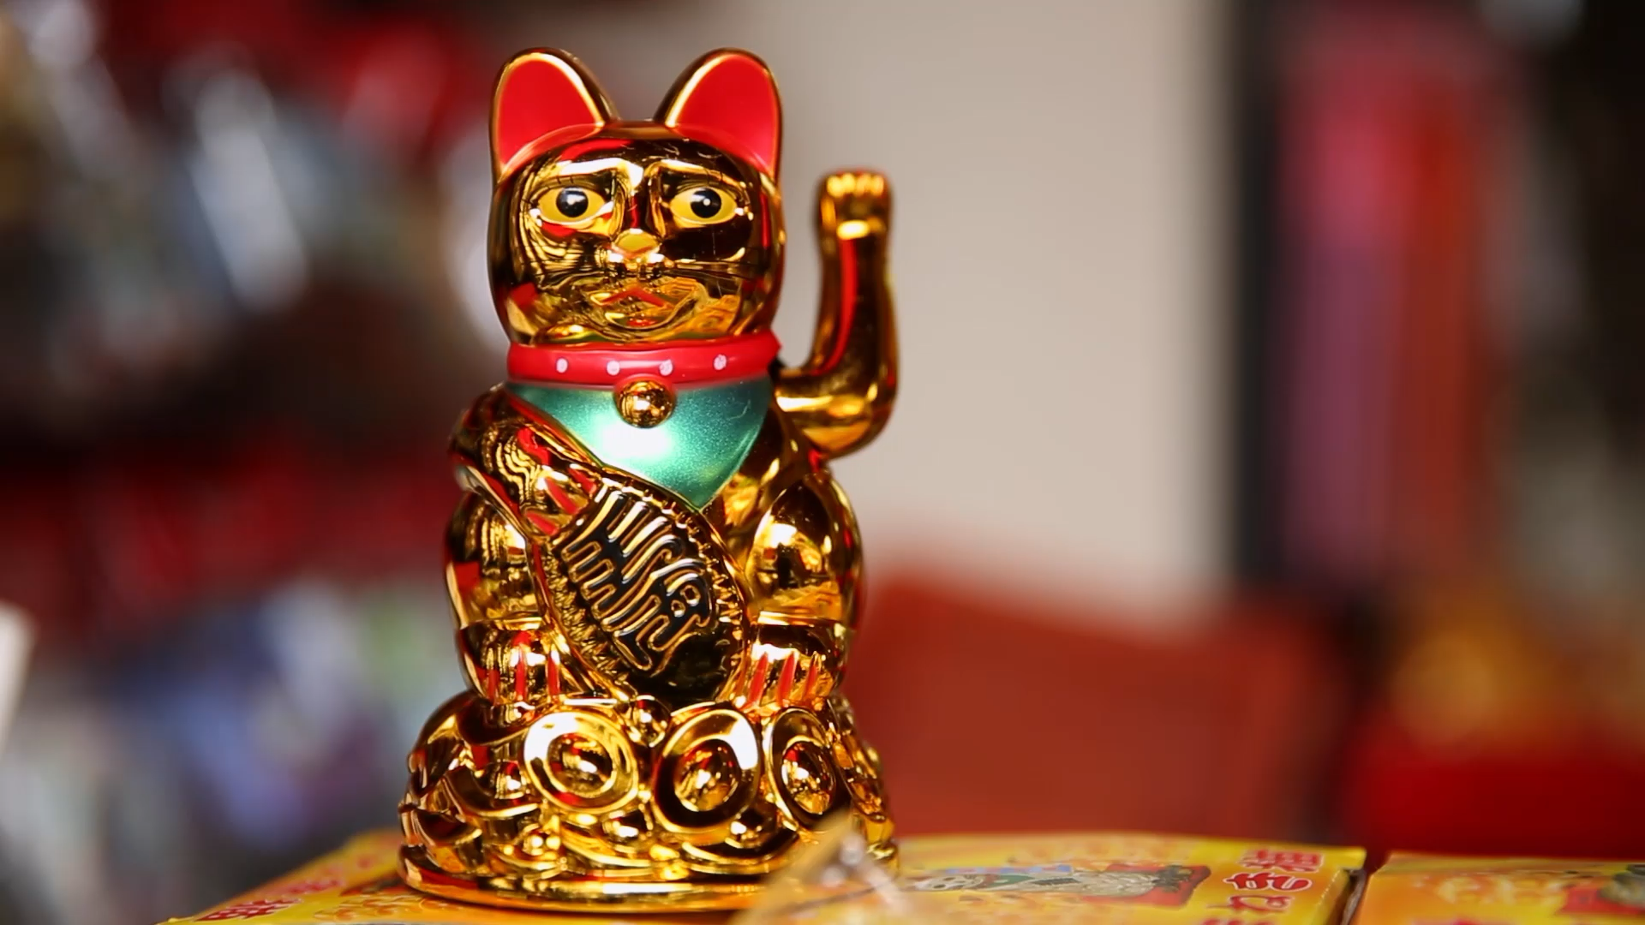
Chinese Traditions
By Matthew Fu

Slide 2
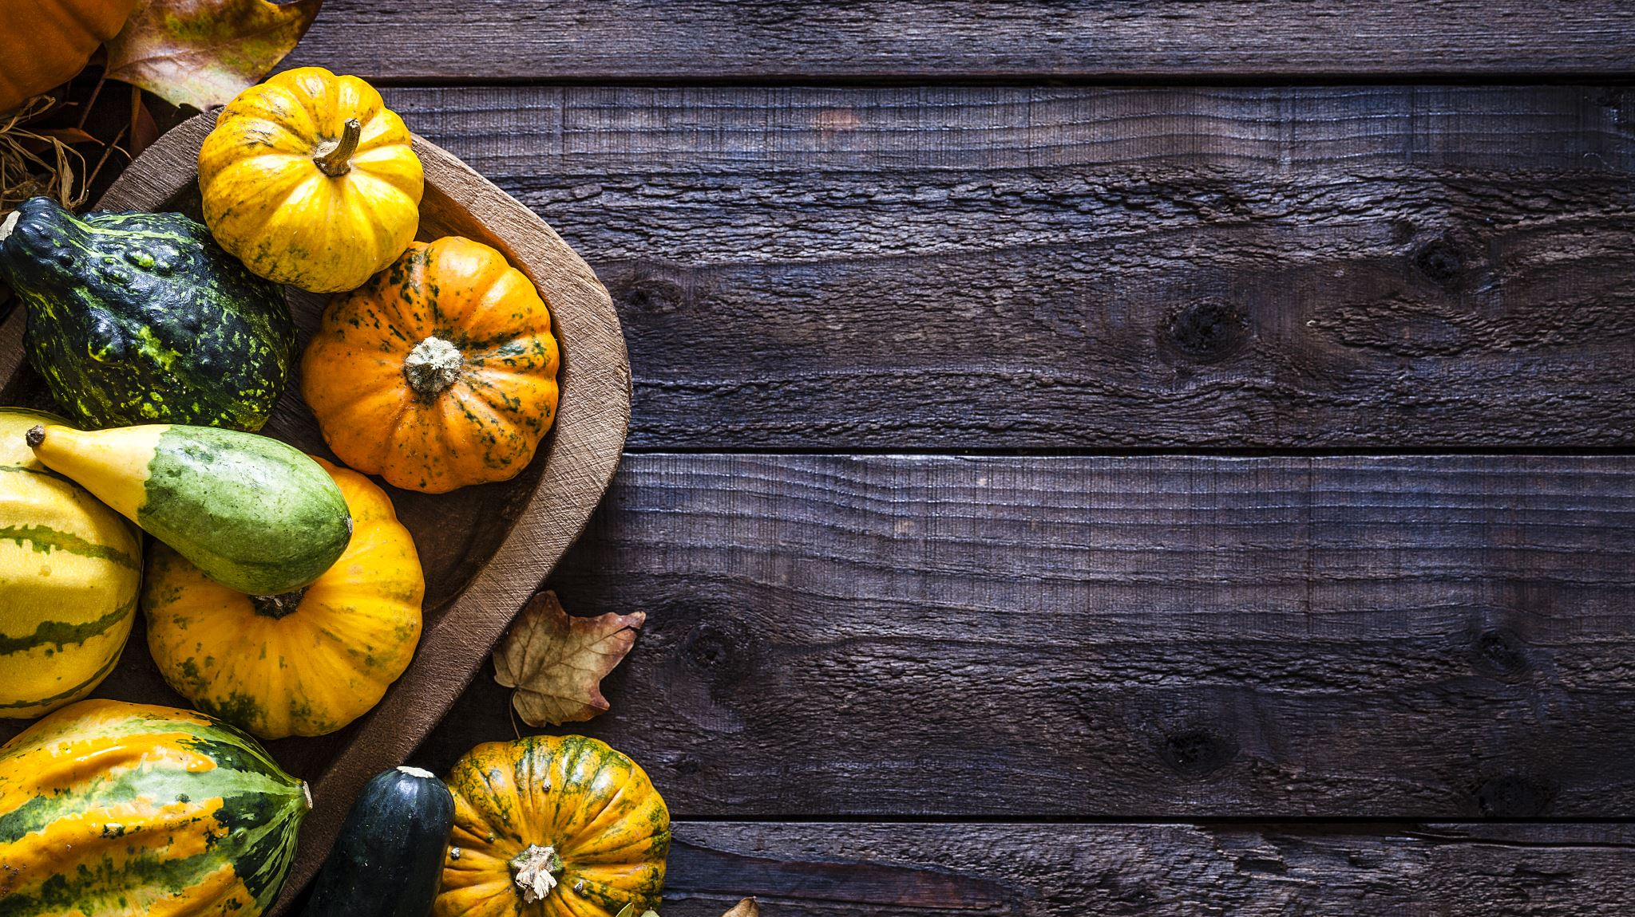
What is a Tradition
It is the transmission of customs or beliefs from generation to generation, or the fact of being passed on in this way.
Some of the traditions we have in the US include:
  Baby showers
  Family dinners on Sunday
  Black Friday
  Thanksgiving
  Labor Day

Slide 3
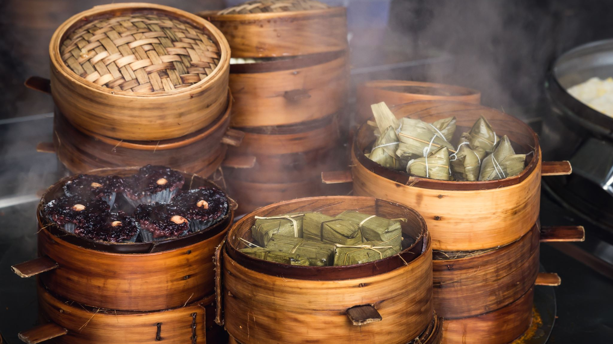
Chinese Traditions
China has been around for over 3,500 years
They have accumulated a plethora of traditions over that time
Some of these traditions include:
  Family style dinner
  Mooncakes
  Eating 饺子 on winter solstice
  Red envelopes

Slide 4
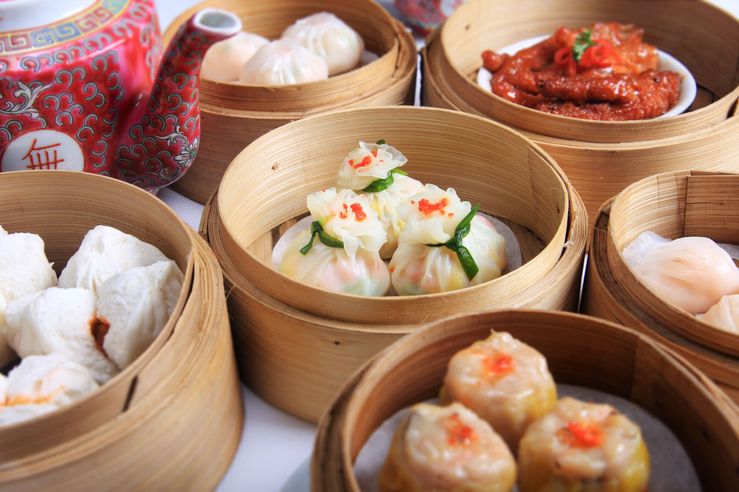
Family Style Dinner
Most Chinese dishes are served family style
Traditionally you serve the eldest or most honorable person first and then move clockwise around the table
You serve one another throughout the meal

Slide 5
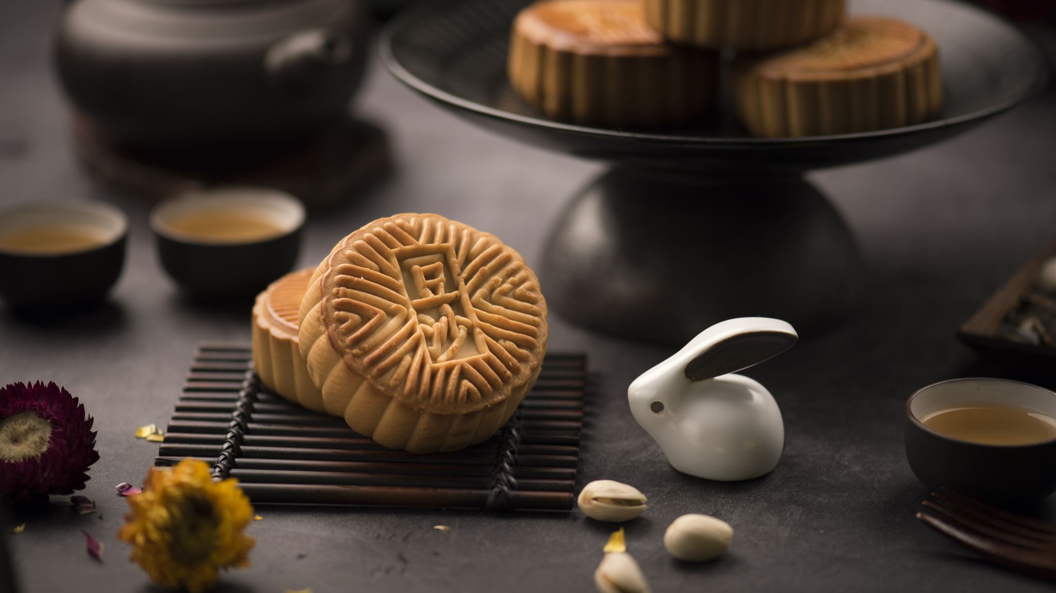
Mooncakes
Mooncakes represent completeness and unity
They are commonly eaten at holidays and family events
The roundness symbolizes completeness and unity
These round mooncakes are shared at the Mid-Autumn Festival

Slide 6
Eating 饺子 on winter solstice
Winter Solstice is seen as one of the most important Chinese holidays
It is the shortest day of the year and shows that the days only get longer from there
Since enters its cold period after this day people got frost bite in ancient times
The only remedy to this was 饺子（jiaozi)

Slide 7
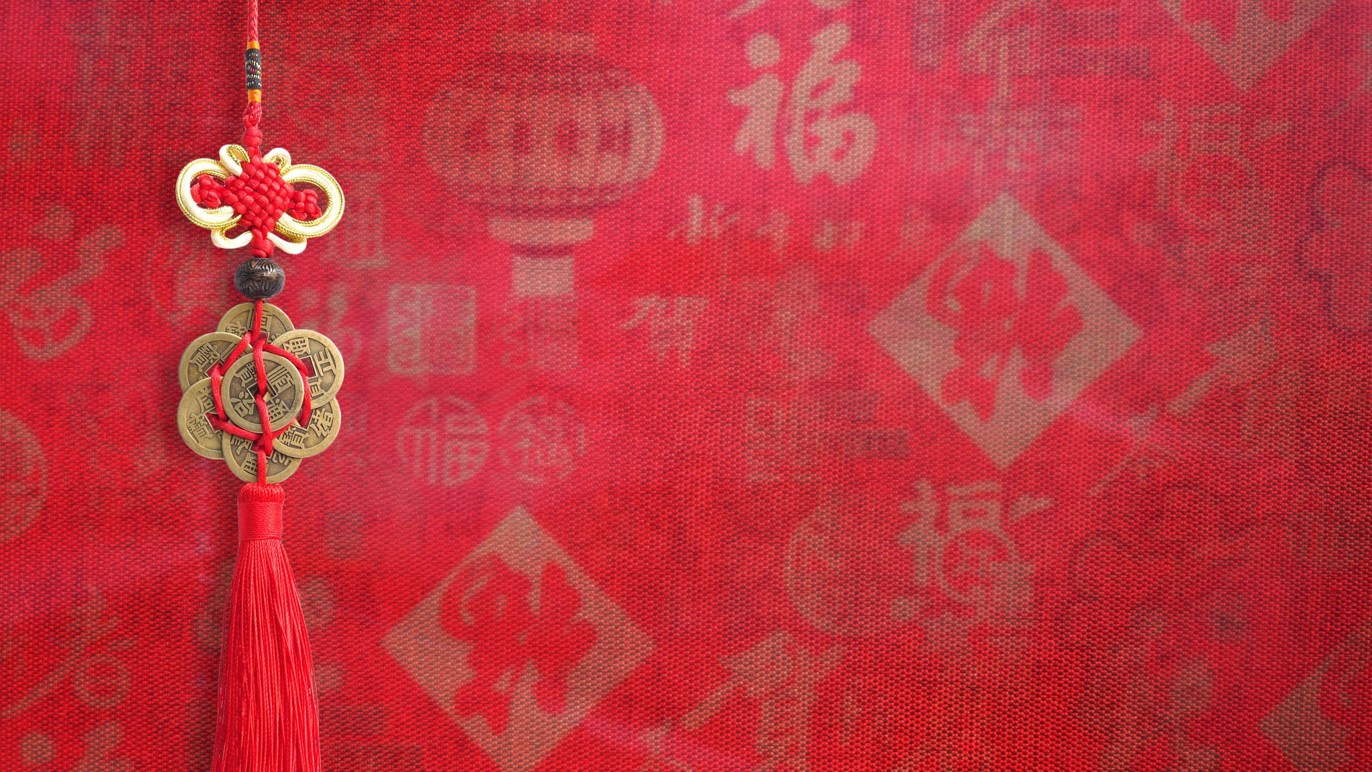
Red Envelopes
They are called 紅包 (Hóngbāo)
This tradition dates back thousands of years
The color red represents good luck and prosperity
One story is about the Sui and how he attacks kids while they sleep on the night before the new year

Slide 8
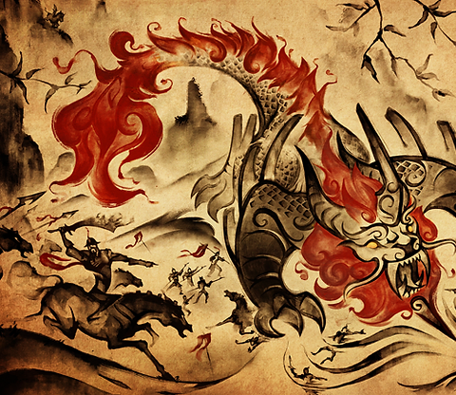
Chinese New year 年 (Nián)

